Slide 1
Tri-County Suburban REALTORS
August 14, 2025
Ryan Judge

Slide 2
SEPTA has worked to piece together its budget
FY2025 balanced with Highway Flex, fare increase and fiscal discipline

Slide 3
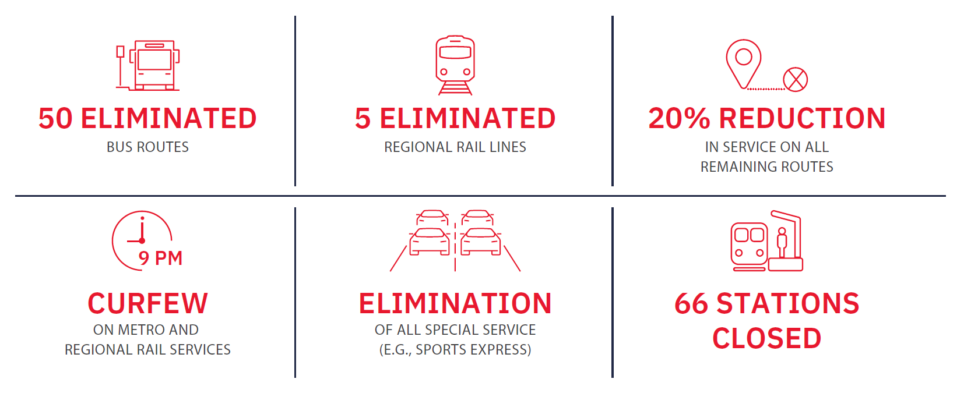
Now, there is nothing left to cut from the budget but service
Without a permanent funding solution, SEPTA will be forced to take drastic steps to irreversibly shrink the system by 45%

Slide 4
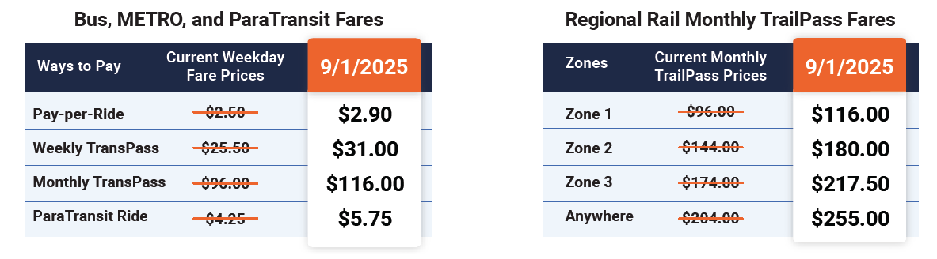
SEPTA fares will be among the highest in the country
SEPTA will move forward with another fare increase that raises rates by more than 20%

Slide 5
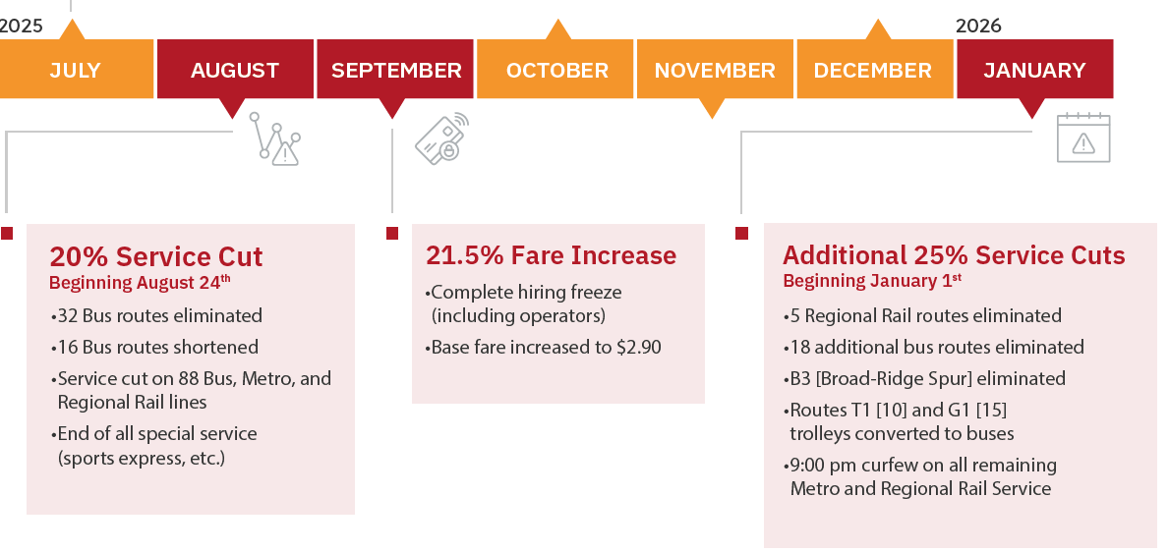
Service reductions take effect beginning in August 2025
Followed by fare increases in September and additional service reductions in January
SEPTA FY2026 budget in effect

Slide 6
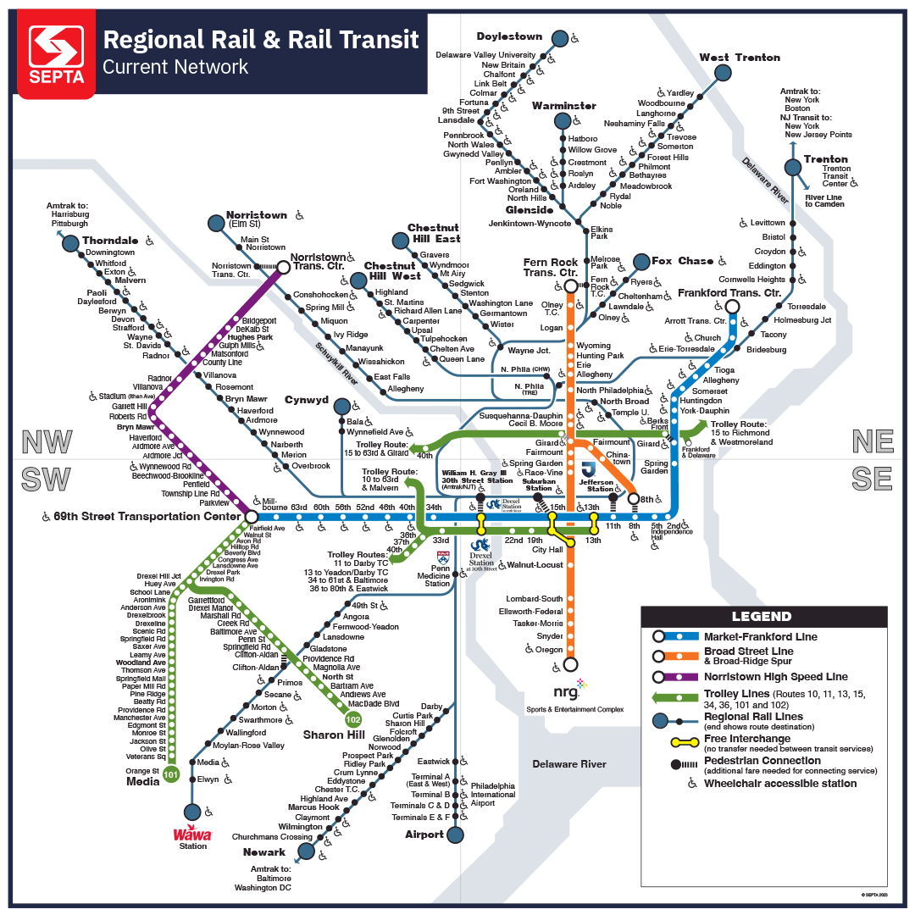
Shrinking Regional Rail
Five Regional Rail Lines eliminated
63 Stations Closed
Service reduced on all remaining lines
9:00pm Curfew
No special services (e.g., Flower Show)

Slide 7
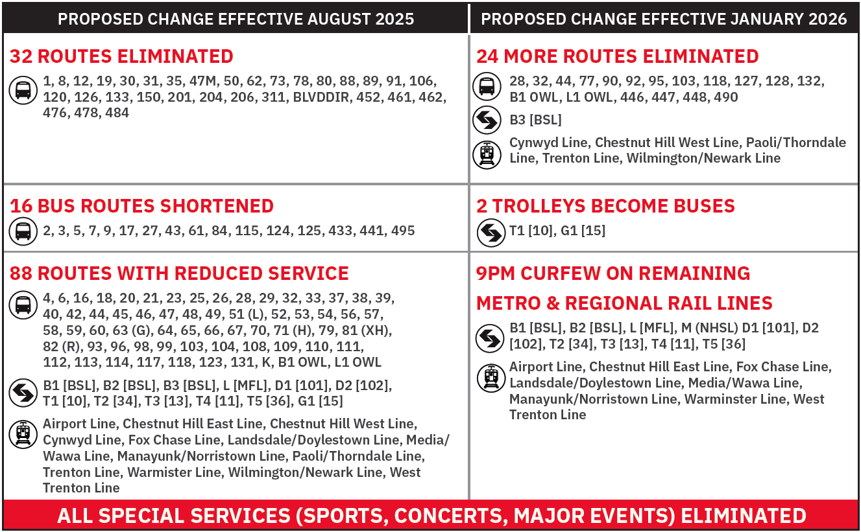
Service reductions across the region start to dismantle the system.
Many lose access to transit service all together.

Slide 8
Service cuts will reverse years of progress.
Largest Transit Police force in a decade
33% drop in serious crime in 2024
100 new cleaners deployed in stations and on vehicles
Ridership growing across the system as service reliability improves
Photo Credit: Tom Gralish, Philadelphia Inquirer
Notes:
410,000 SEPTA passengers during Eagles Parade.
SEPTA carried 45% of the Linc’s capacity during the NFC Championship Game

Slide 9
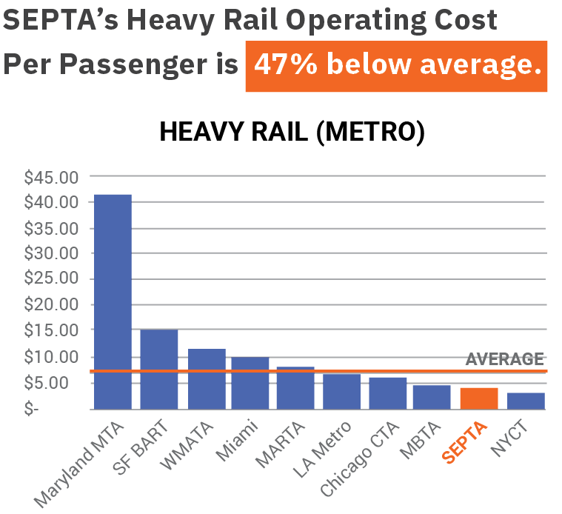
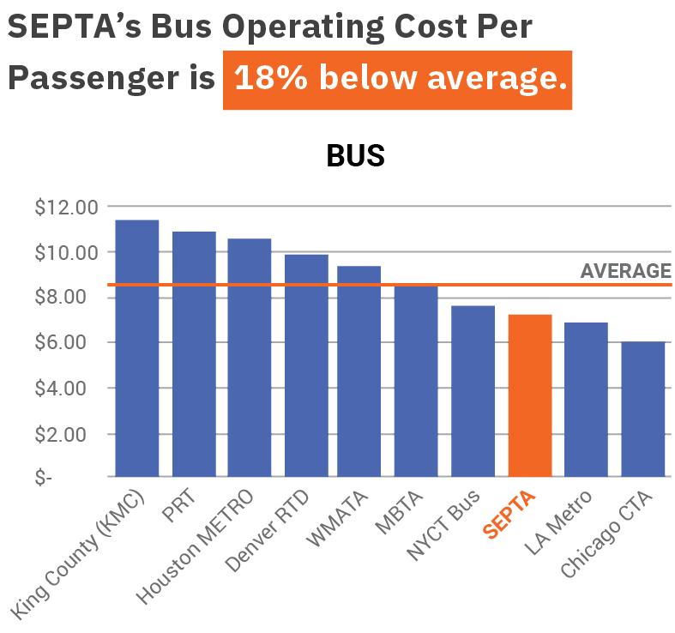
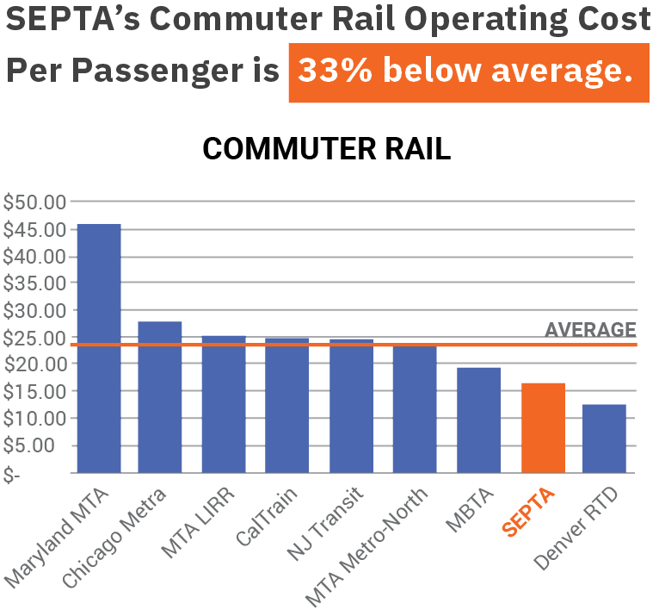
SEPTA moves people more efficiently than nearly any U.S. transit agency
Years of lean operations & implementation of best practices makes SEPTA a leader.
Source: National Transit Database (NTD), 2023

Slide 10
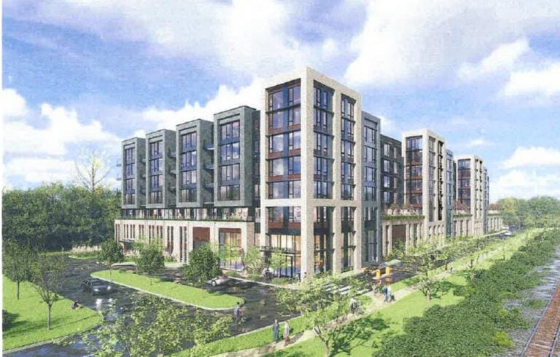
Fiscal discipline has deepened efficiency even further
Efficiency Program, austerity measures, and new revenue-generating initiatives are adding value.
Austerity measures implemented across the board, saving $30 million per year:
Selective hiring freeze and management pay freeze
Reduction in contract and consultant services
Ban on travel and all discretionary expenses
SEPTA increased fares and reinstated parking fees to increase revenue:
Increased fares by 7.5% in Dec 2024, generating $14 m
Reinstated parking fees, generating $4m
SEPTA has doubled non-farebox revenue from $21.5m in FY2005 to a forecast $48m in FY2026, including:
$14m in advertising
$7.3m leasing office and retail space across SEPTA
$8.8m in property leases for fiberoptics & utilities
$3.5m in Station Naming Rights deals
SEPTA’s Board approved a 99-year land lease valued at $332 million at Conshohocken Station.
Alterra Property Group mixed-use proposal.

Slide 11
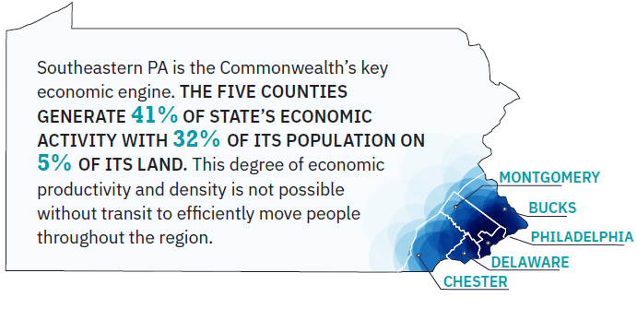
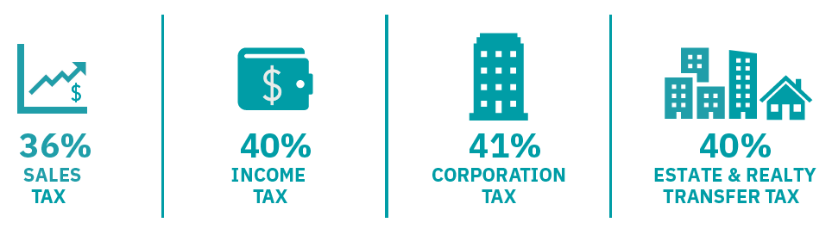
SEPTA drives Pennsylvania’s Economy
As SEPTA goes, so does the Region and Commonwealth

Slide 12
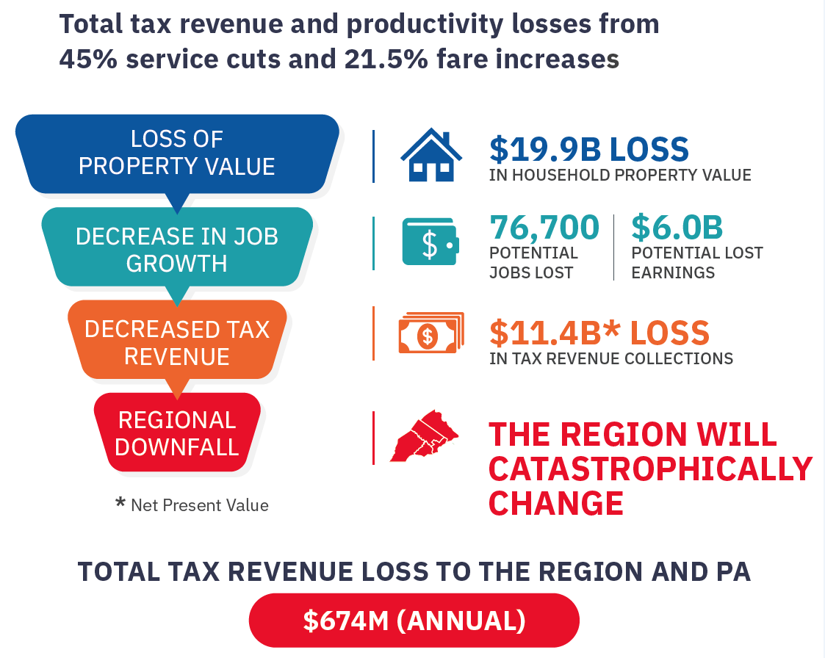
SEPTA will lose its ability to serve as the region’s economic engine
Businesses rely on transit to attract workers - without it, companies will reconsider staying in or relocating to Greater Philadelphia.
The nighttime economy will suffer. Restaurants, entertainment venues and shift workers in healthcare and more will struggle without evening rail options.
Job growth will slow, businesses will rethink staying in or locating here, and state and local tax revenues will shrink to the tune of $675 million a year.

Slide 13
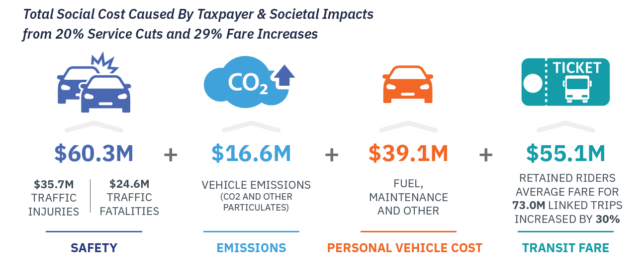


More people driving causes reduced quality of life for everyone
Higher fares increase cost burden for both those who still need transit and those who switch to driving
TOTAL SOCIAL COST
$267M (Annual)
$112.2M
$51.6M
$62.1M
$41.4M
39.8M more auto trips
(248M Additional Regional Vehicle Miles Traveled)
$69.0M
$43.2M
21.5%
Notes:
More than 350,000 people will stop riding SEPTA due service cuts and fare increases – that’s more people than the busiest section of I-95 carries in a day.

Slide 14
Disinvestment in transit leads to decreased state and local tax revenue
Increased property tax burden across all jurisdictions, particularly local school districts
Annual Residential Property Tax Revenue Losses from Service Reductions
 | Total | School Districts | Municipalities | County
Bucks | ($3) | ($2) | ($0.3) | (0.4)
Chester | ($55) | ($45) | ($4) | ($7)
Delaware | ($16) | ($11) | ($3) | ($2)
Montgomery | ($115) | ($90) | ($12) | ($12)
Philadelphia | ($107) | ($59) | ($49)
Total | ($296) | ($207) | ($67) | ($22)
Commercial Property Value At Risk
Property tax revenue loss forecasts do not account for reduction in commercial property value, which account for $73 billion in assessed value around stations that will be closed – all of which is at risk without transit.

Slide 15
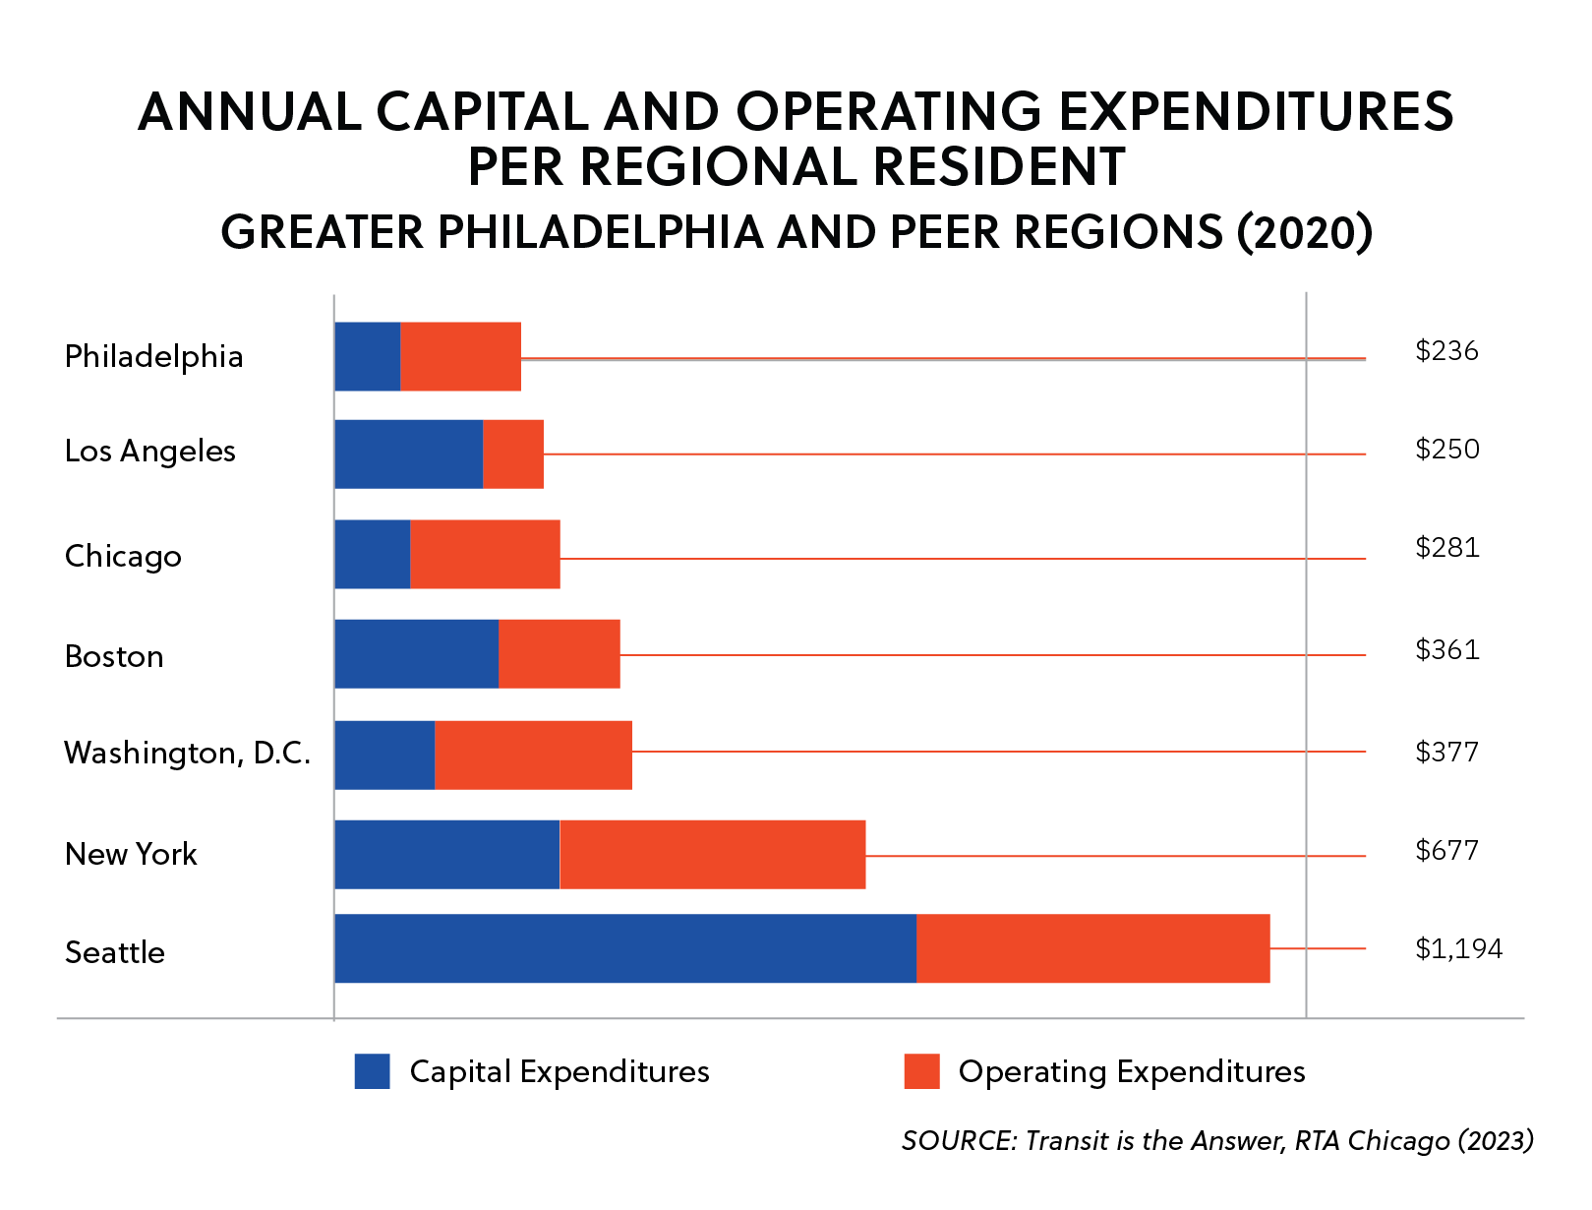
SEPTA was created to maintain our region’s transit system but was never given adequate funding to meet this challenge
SEPTA receives less capital AND operating funds per capita than any of our peers

Slide 16
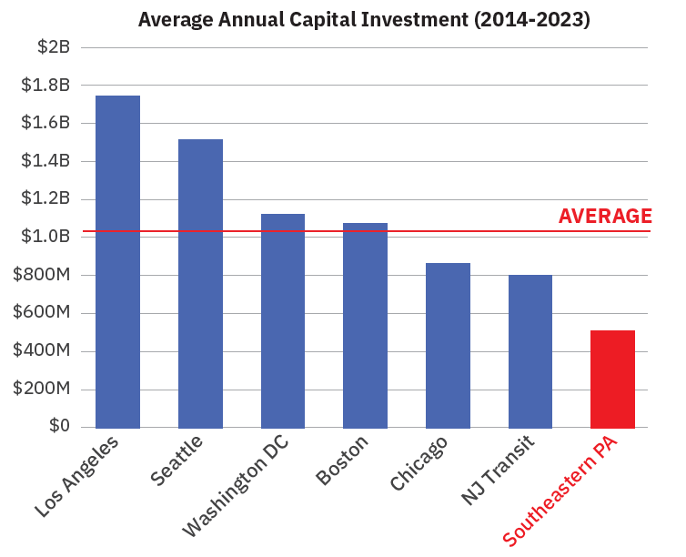
Over the last decade, peer regions have invested twice as much in their transit system compared to Southeastern PA
Infrastructure debt continues to accumulate year after year without investment

Slide 17
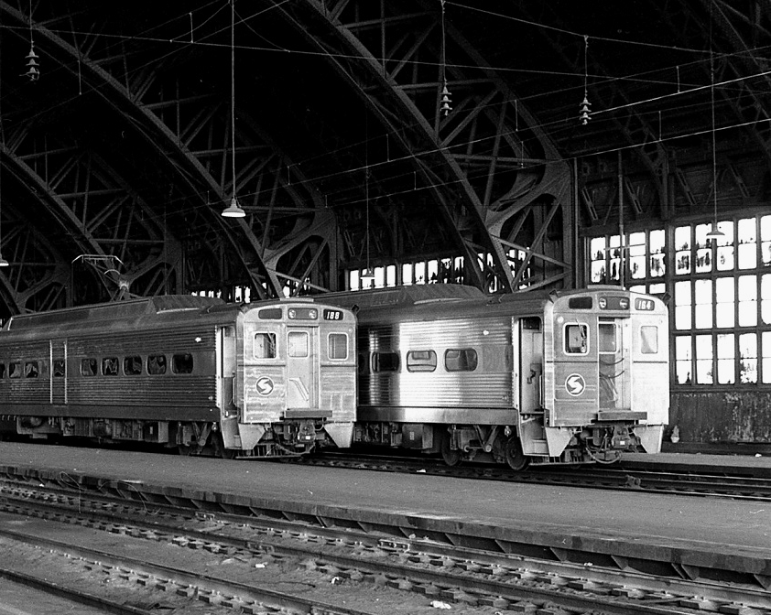
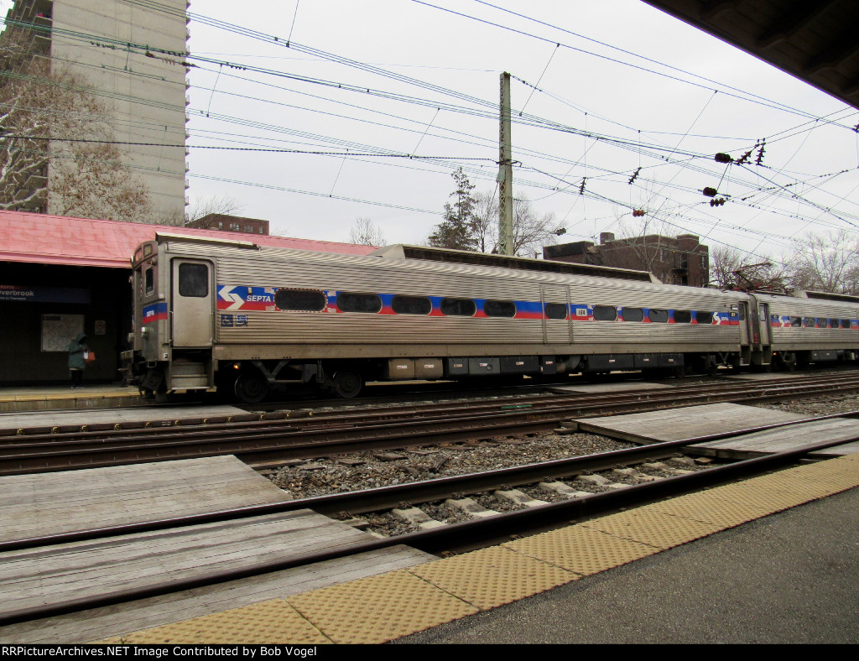
SEPTA operates one of the oldest rail fleets in the country
Two out of Three Regional Rail Cars are from 1970s – when Nixon was President
1974
2025
Train #164
Train #164

Slide 18
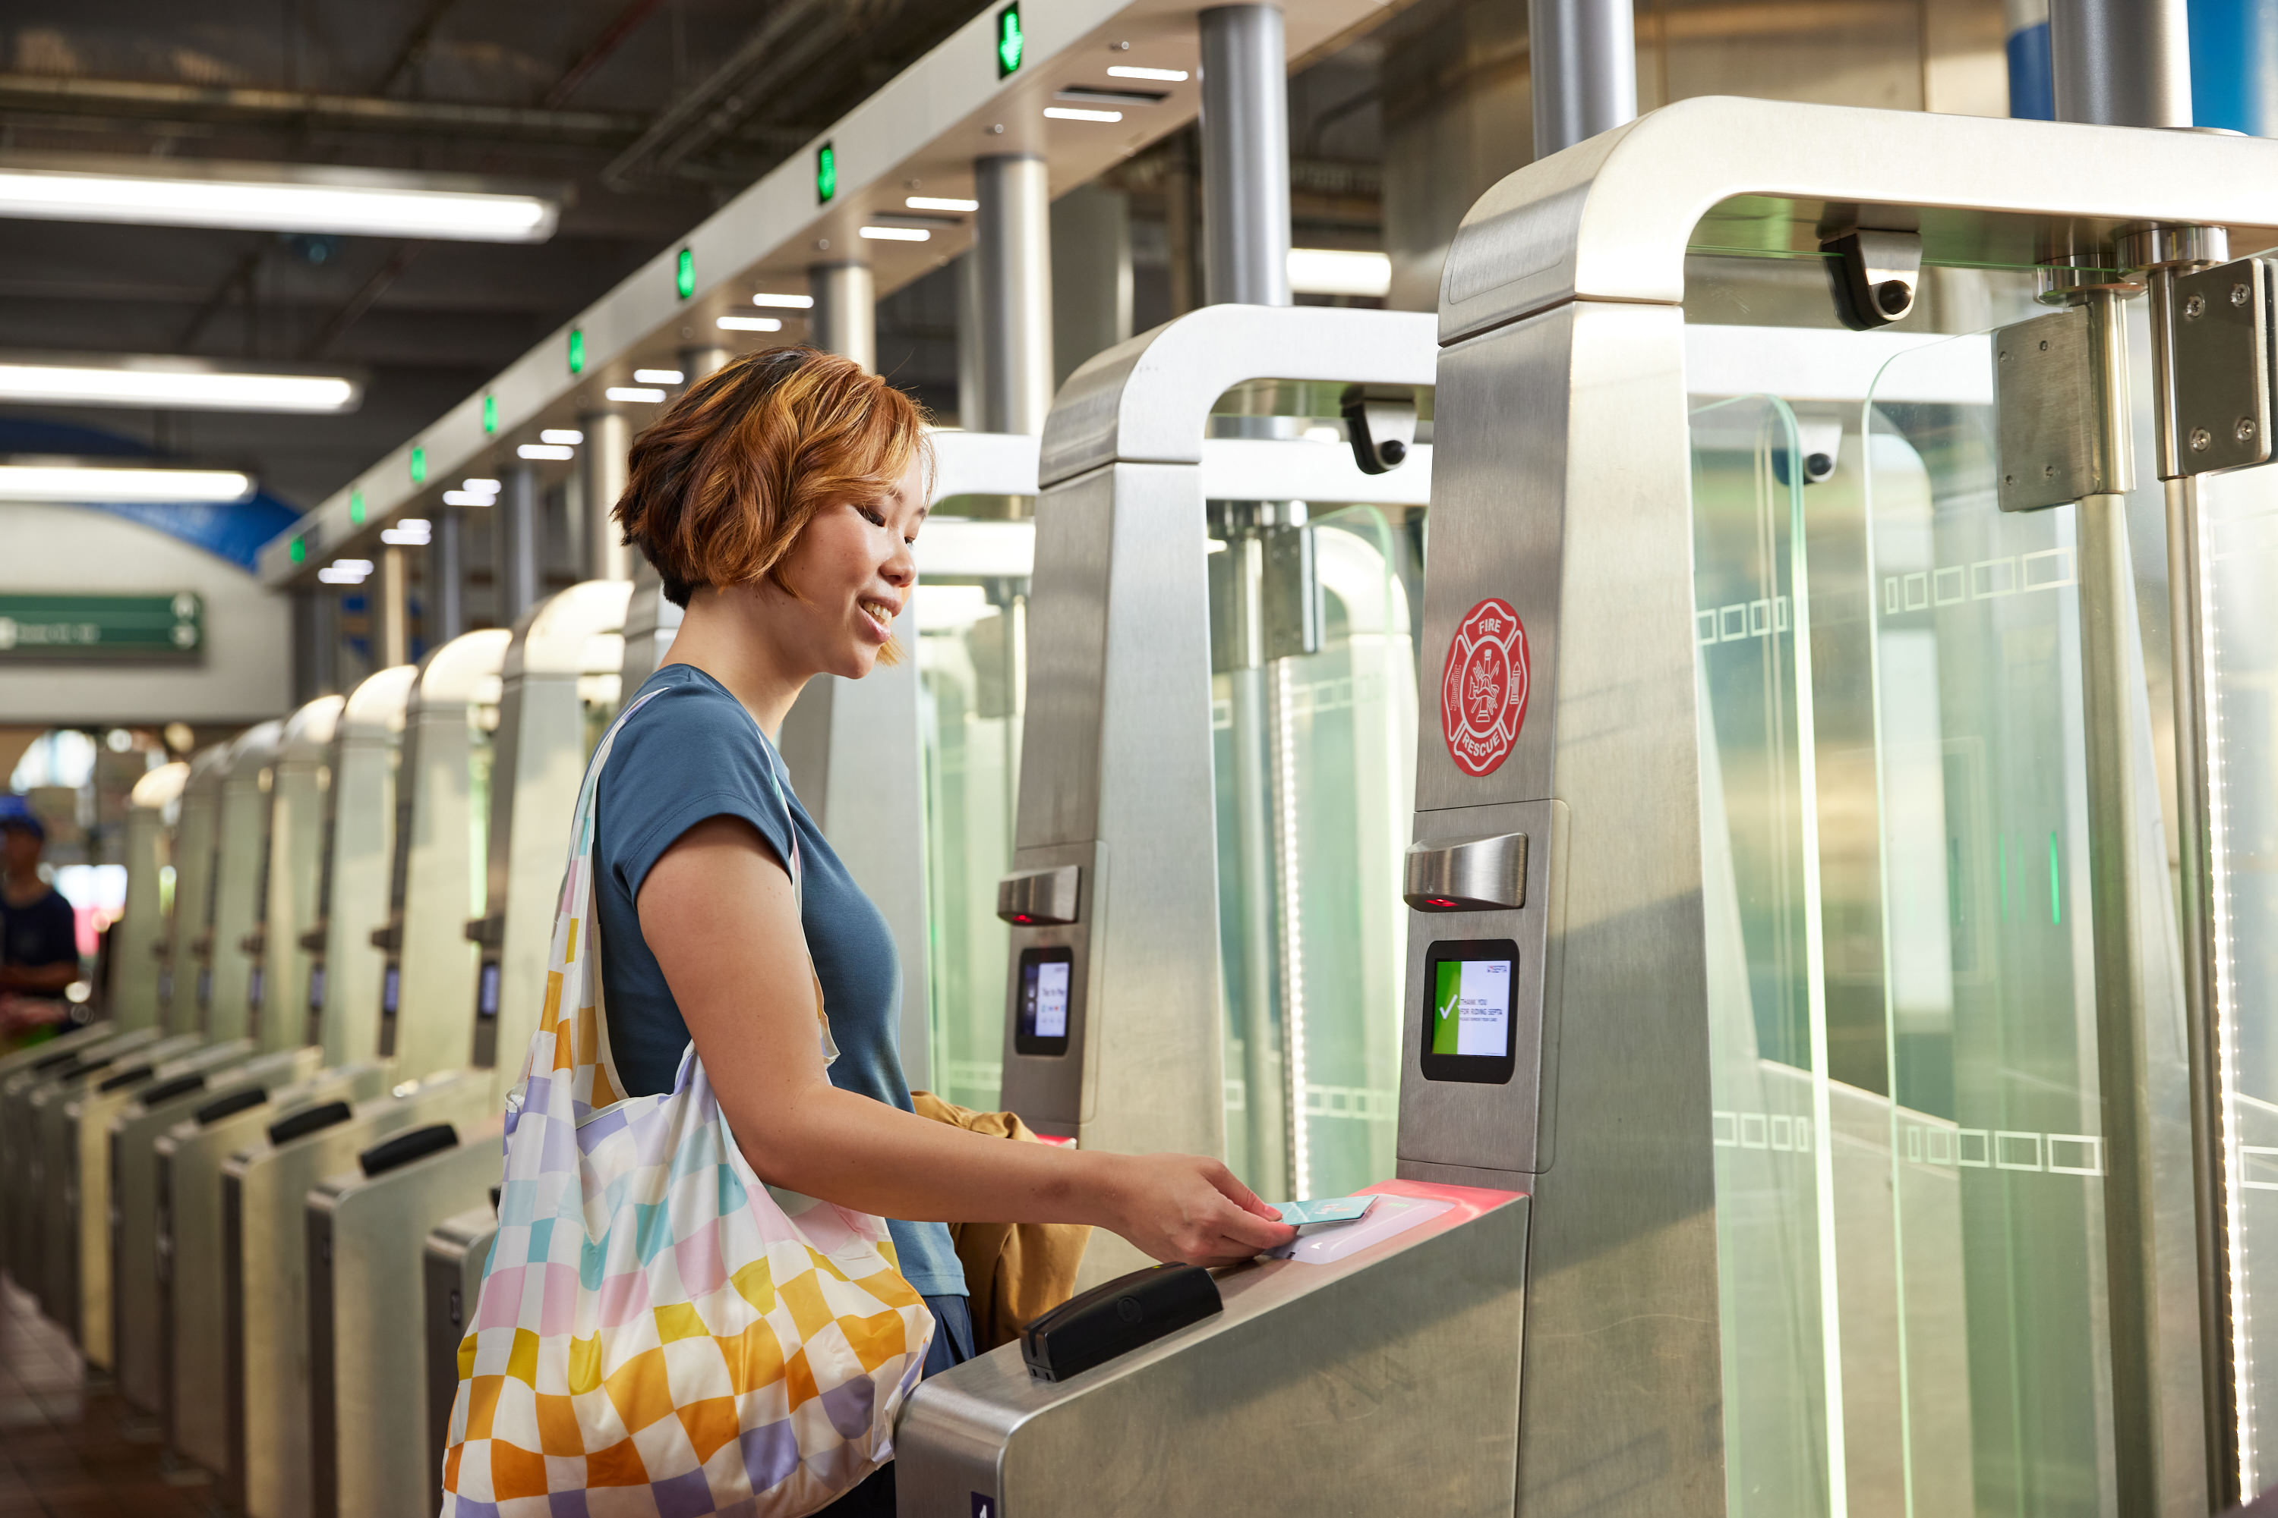
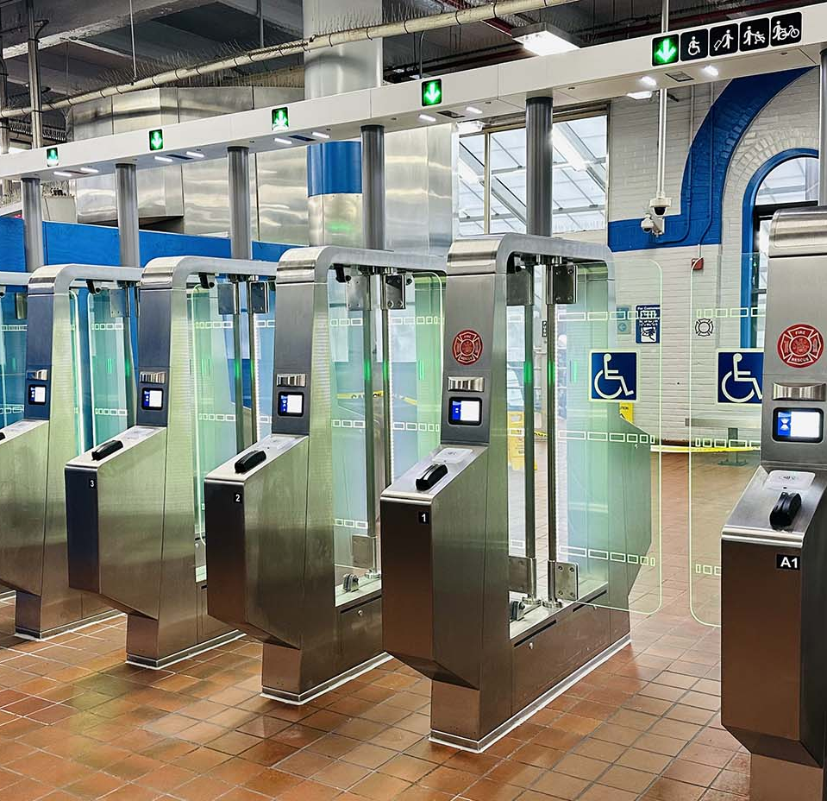
New Fare Gates

Slide 19
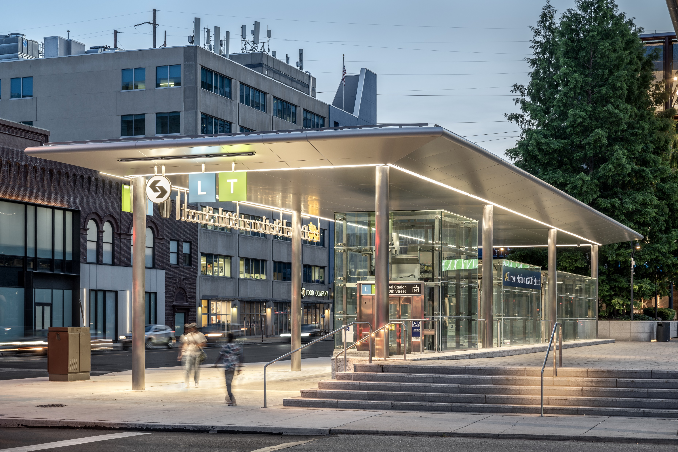
Renovated 30th Street Station

Slide 20
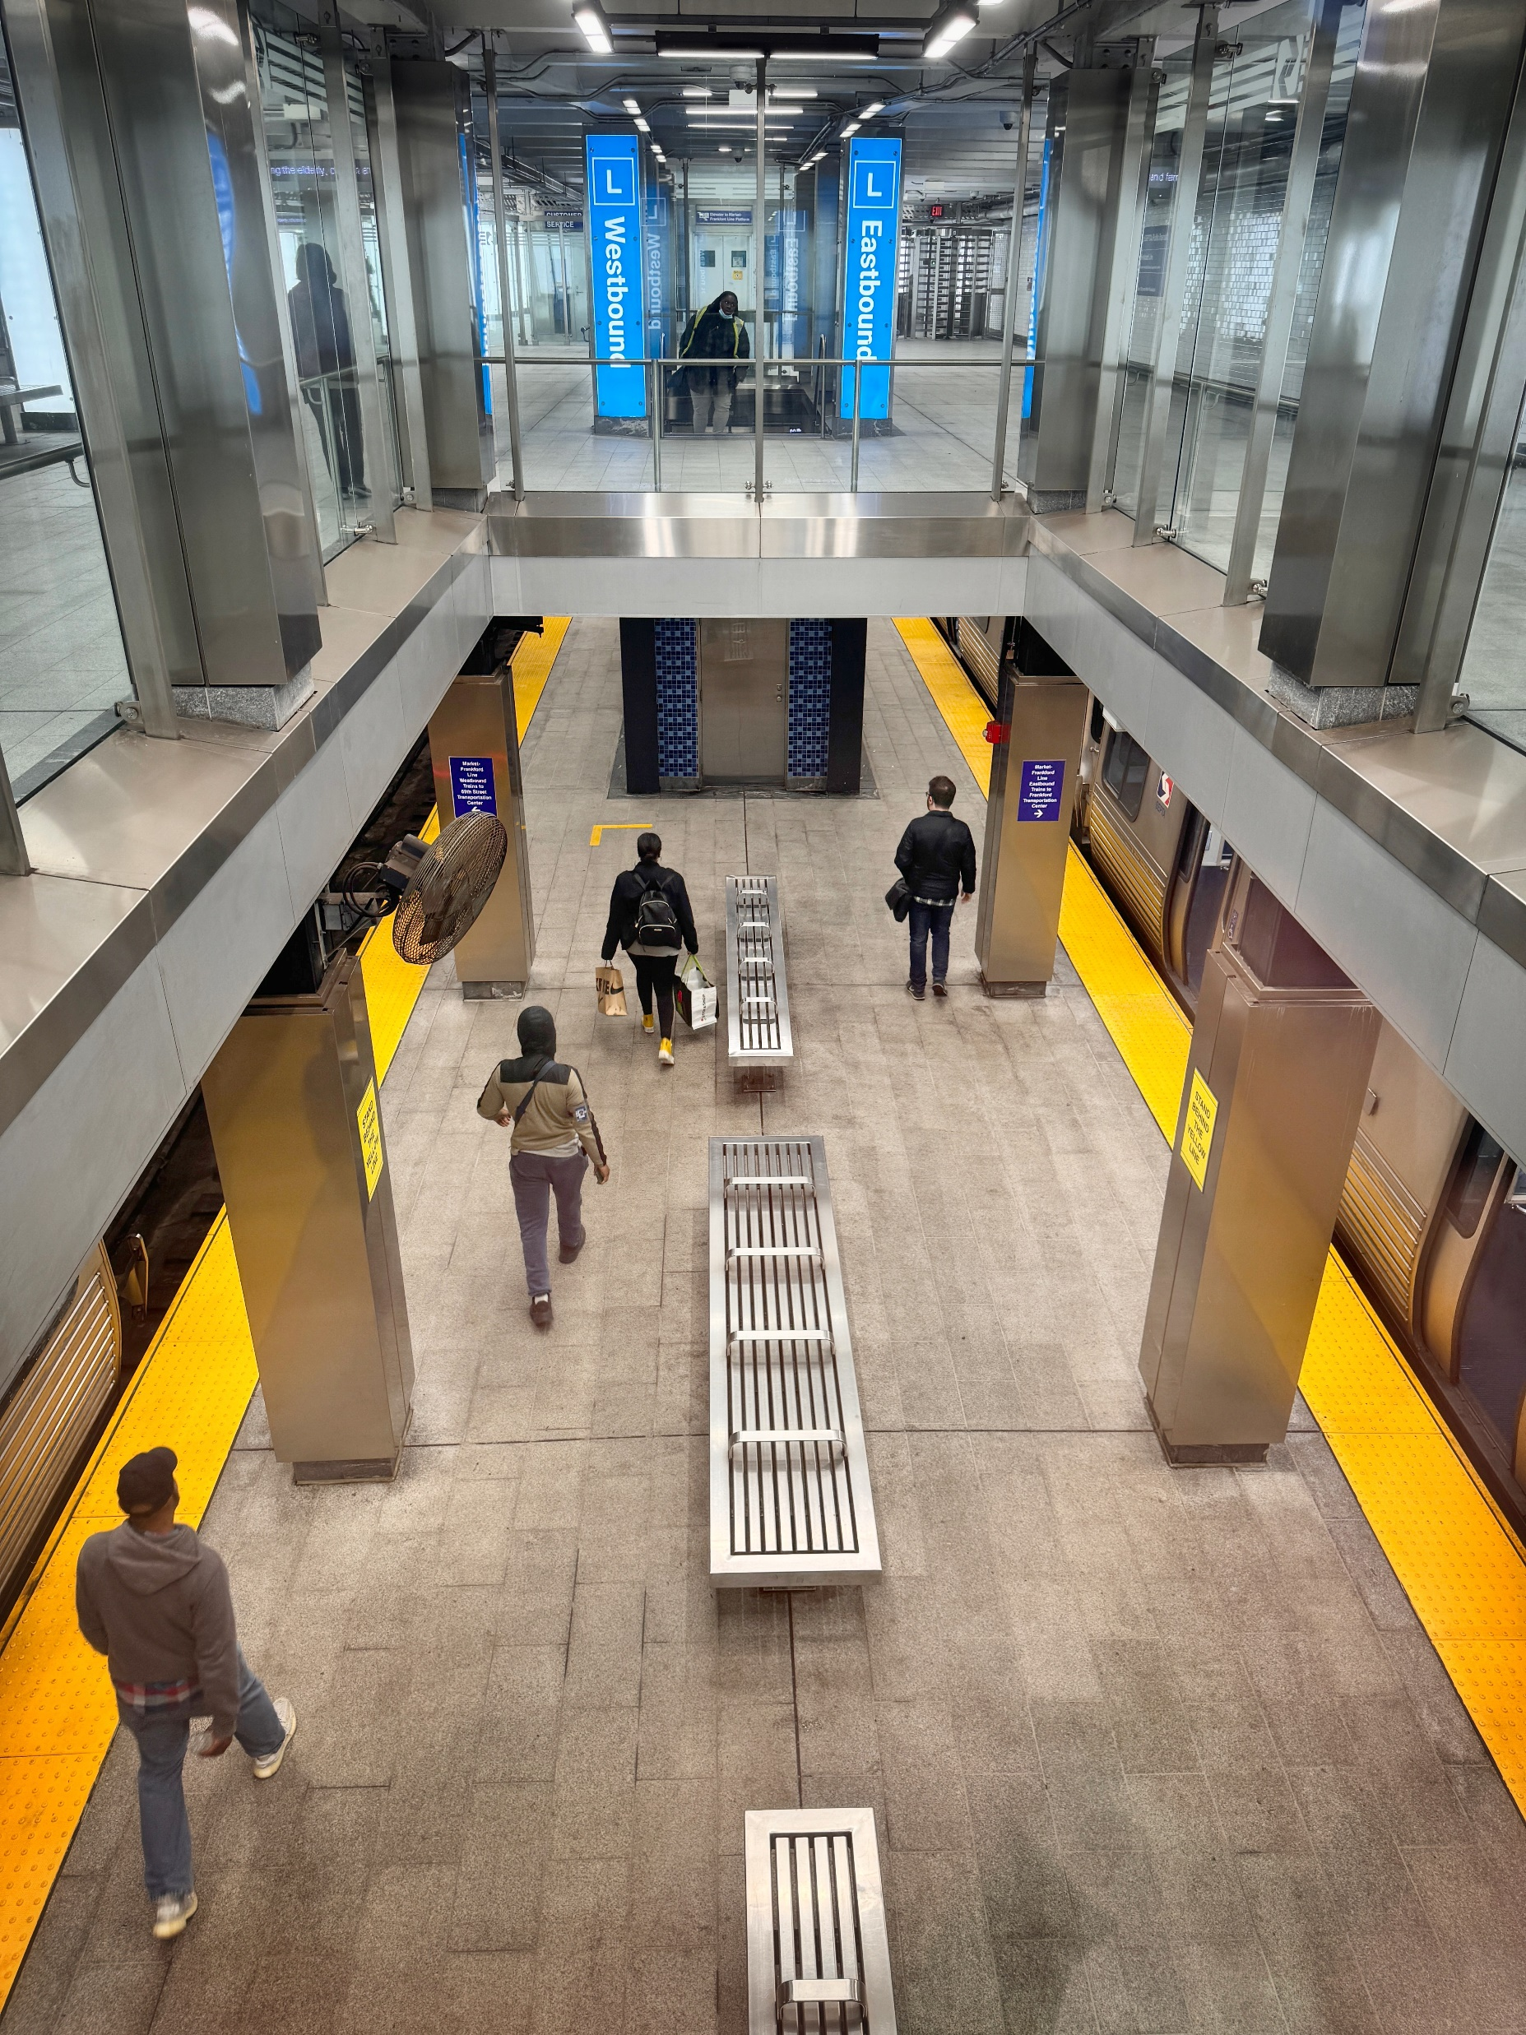
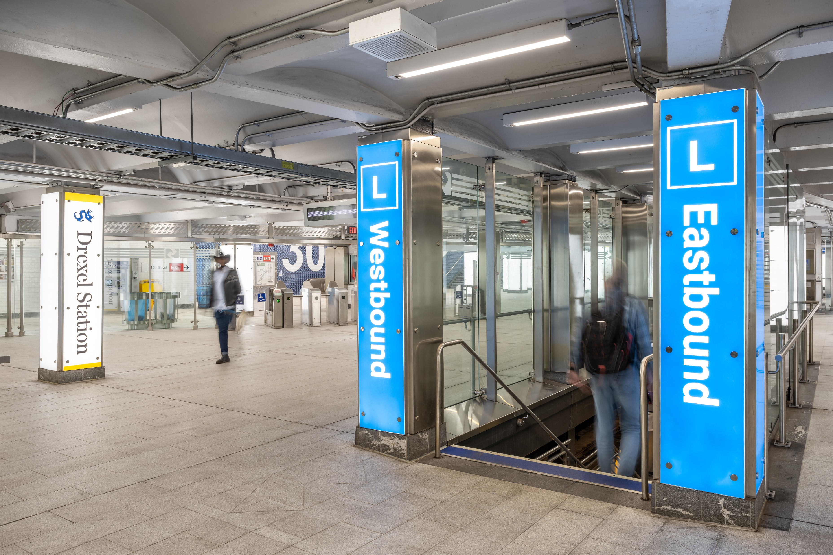
Renovated 30th Street Station

Slide 21
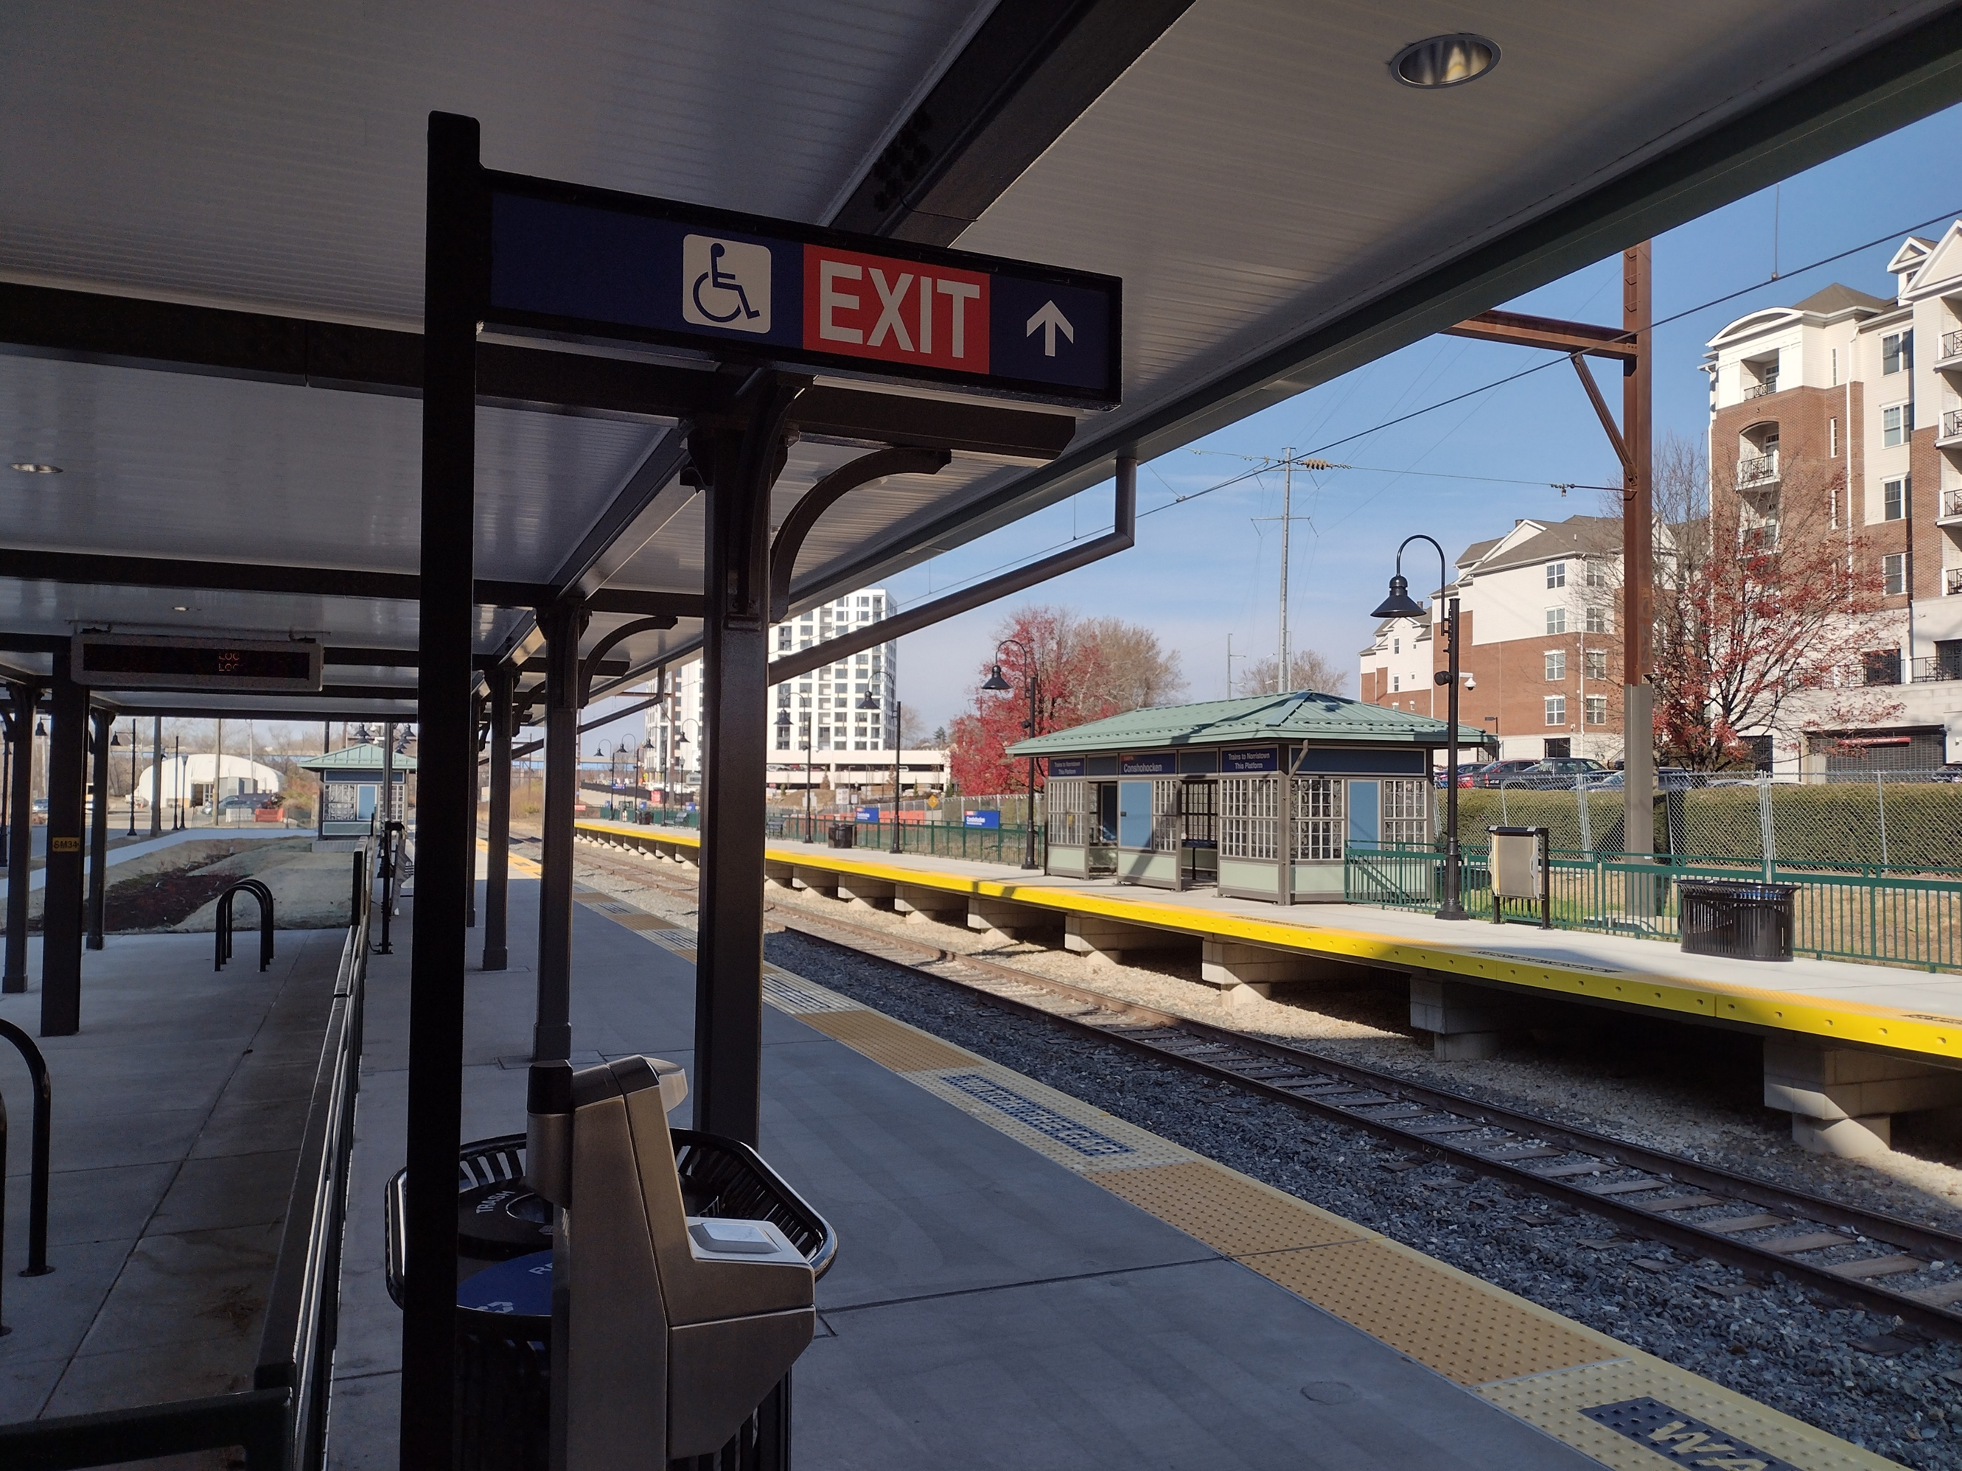
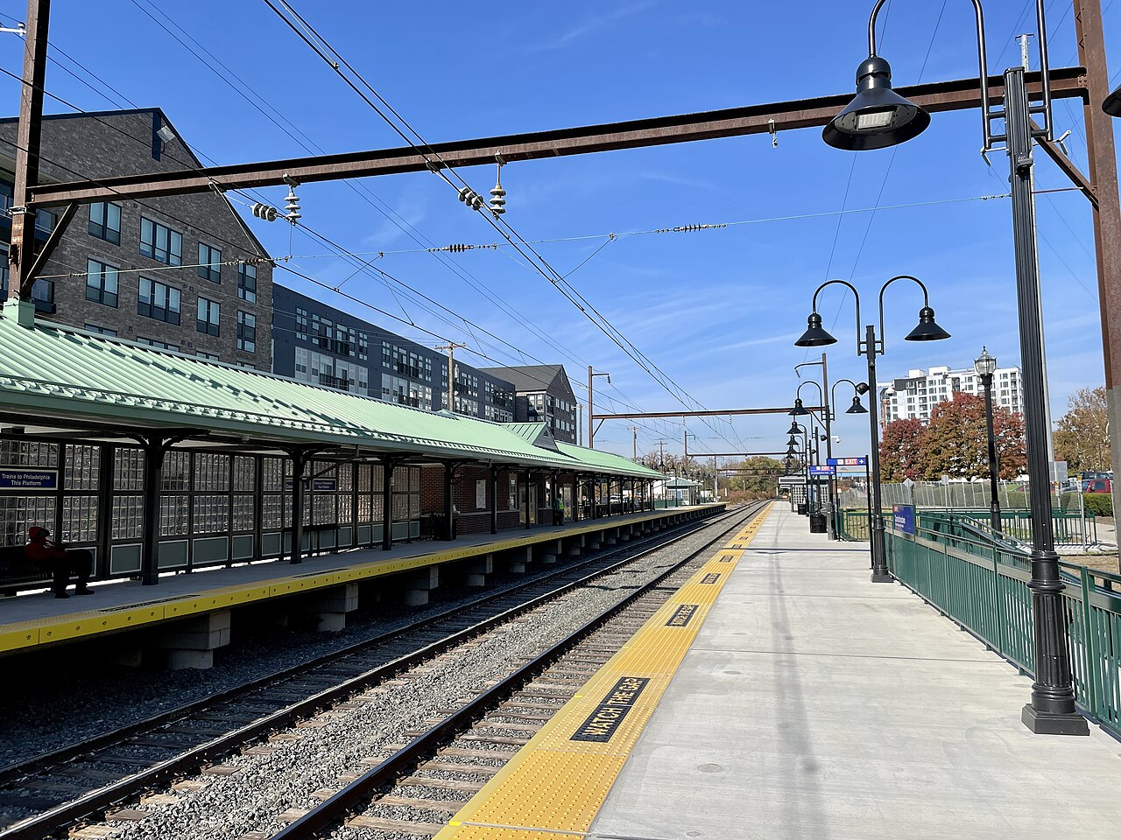
Regional Rail Station Upgrades

Slide 22
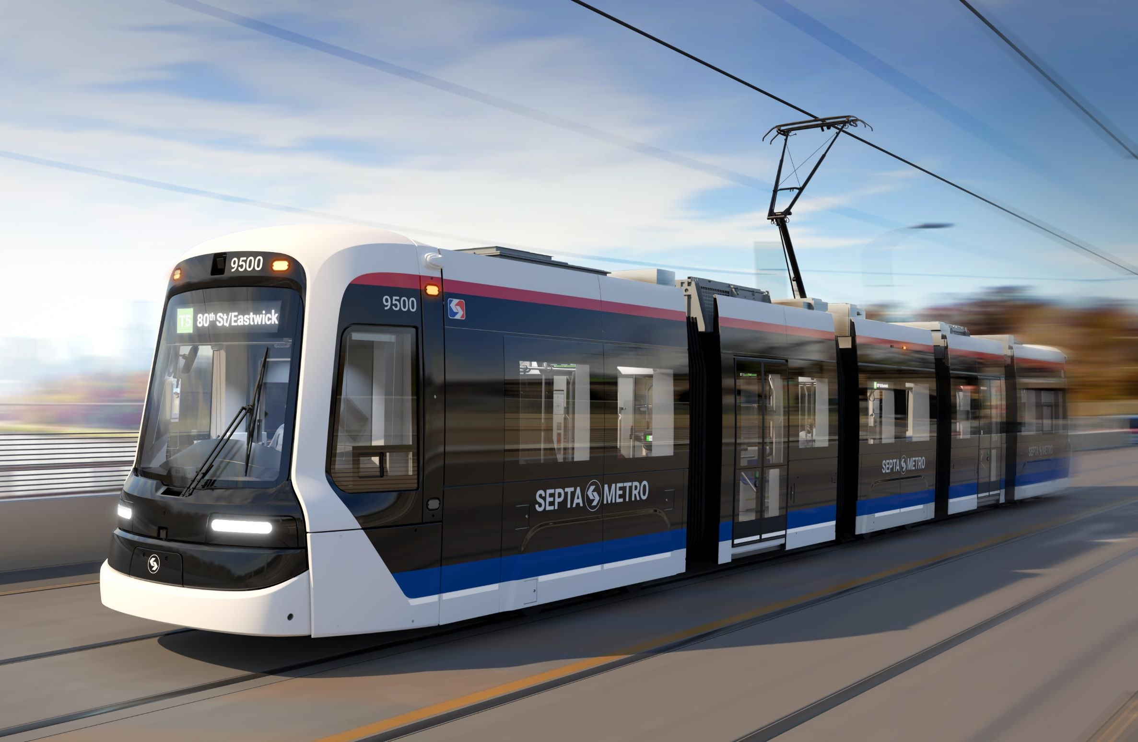
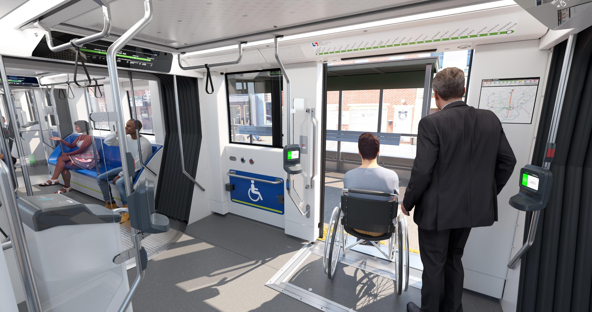
New, Modern Trolley Vehicles

Slide 23
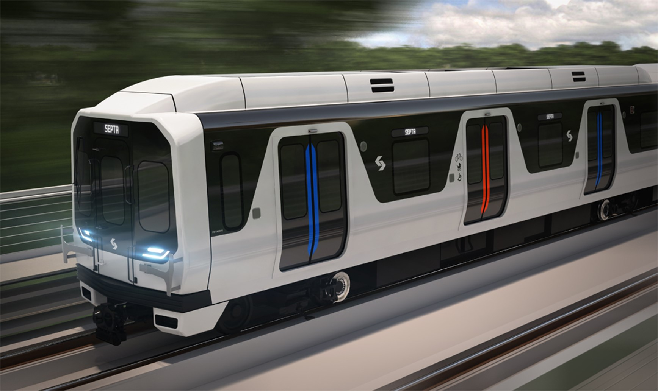
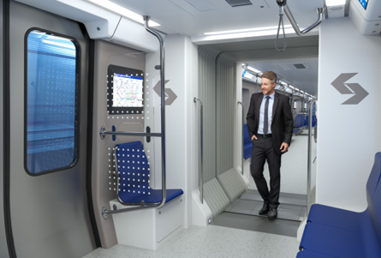
New Market Frankford Line Vehicles

Slide 24
Tri-County Suburban REALTORS
August 14, 2025
Ryan Judge

